Slide 1
Bot squad week 3
Regression

Slide 2
What is regression?
Regression is a statistical ML technique used to analyse the relationship between a dependent variable and one or more independent Variables.
Primarily used for predictive modelling and understanding how changes in the independent variables can influence the outcome.

Slide 3
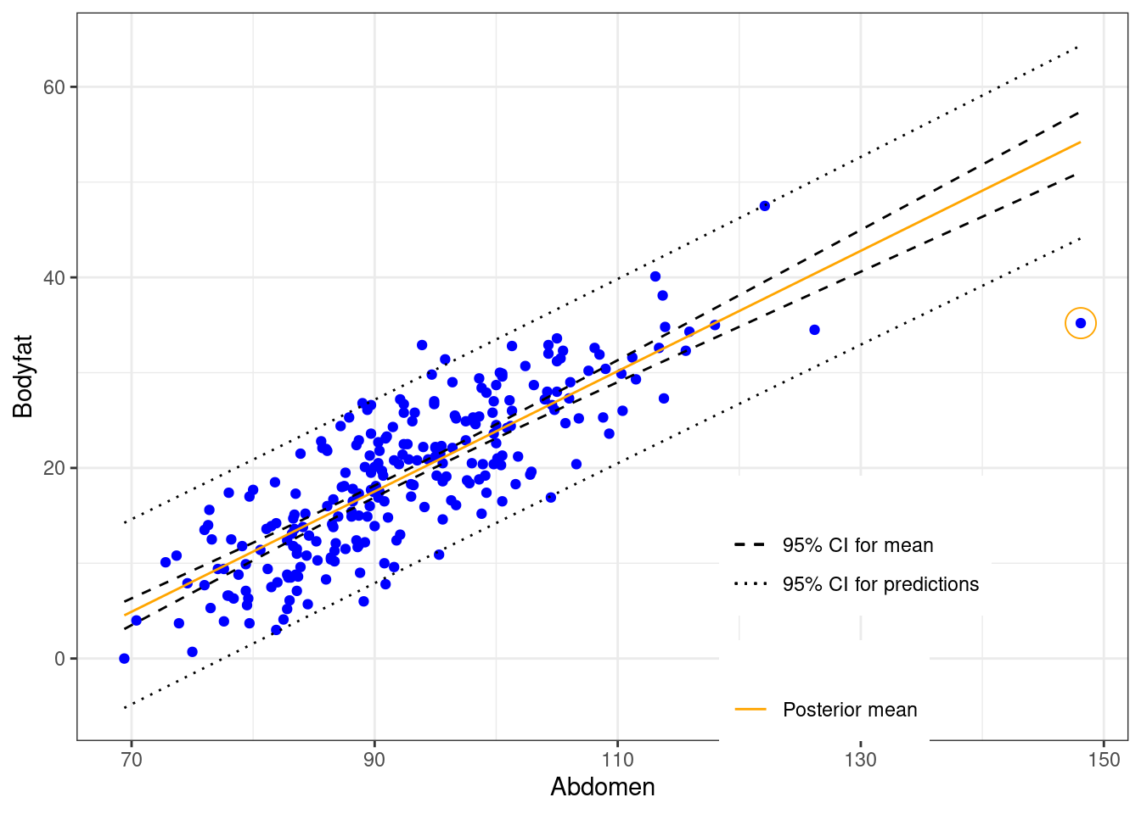
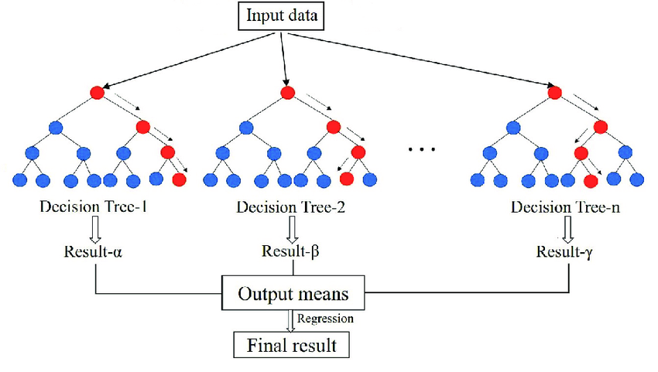
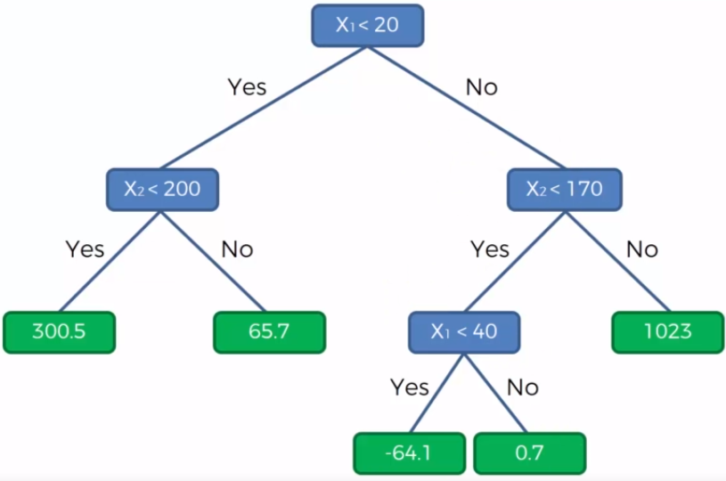
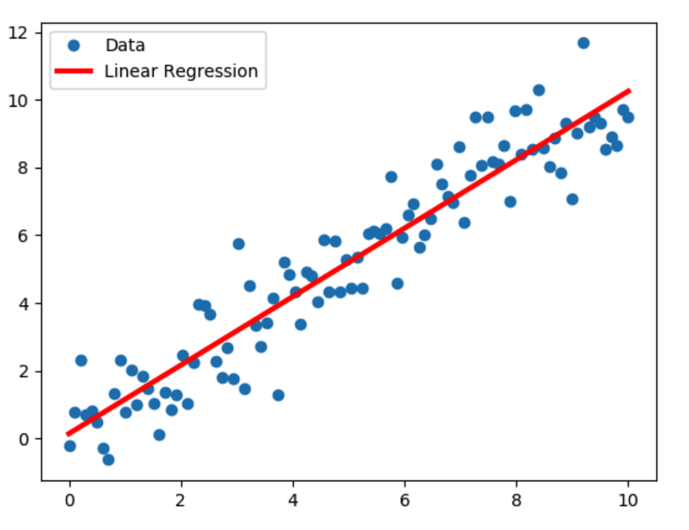
What are the main types of regression?
Linear Regression
Decision Tree Regression
Random Forest Regression
Bayesian Regression

Slide 4
Linear regression
Linear regression is the simplest form of regression.
It assumes there is a linear relationship between the input and output – meaning the output changes at a constant rate as the input changes.
A line of best fit is drawn through all the data points which is represented by the equation: y = mx + c.

Slide 5
What do the letters in the equation represent?
y = mx + c

Slide 6
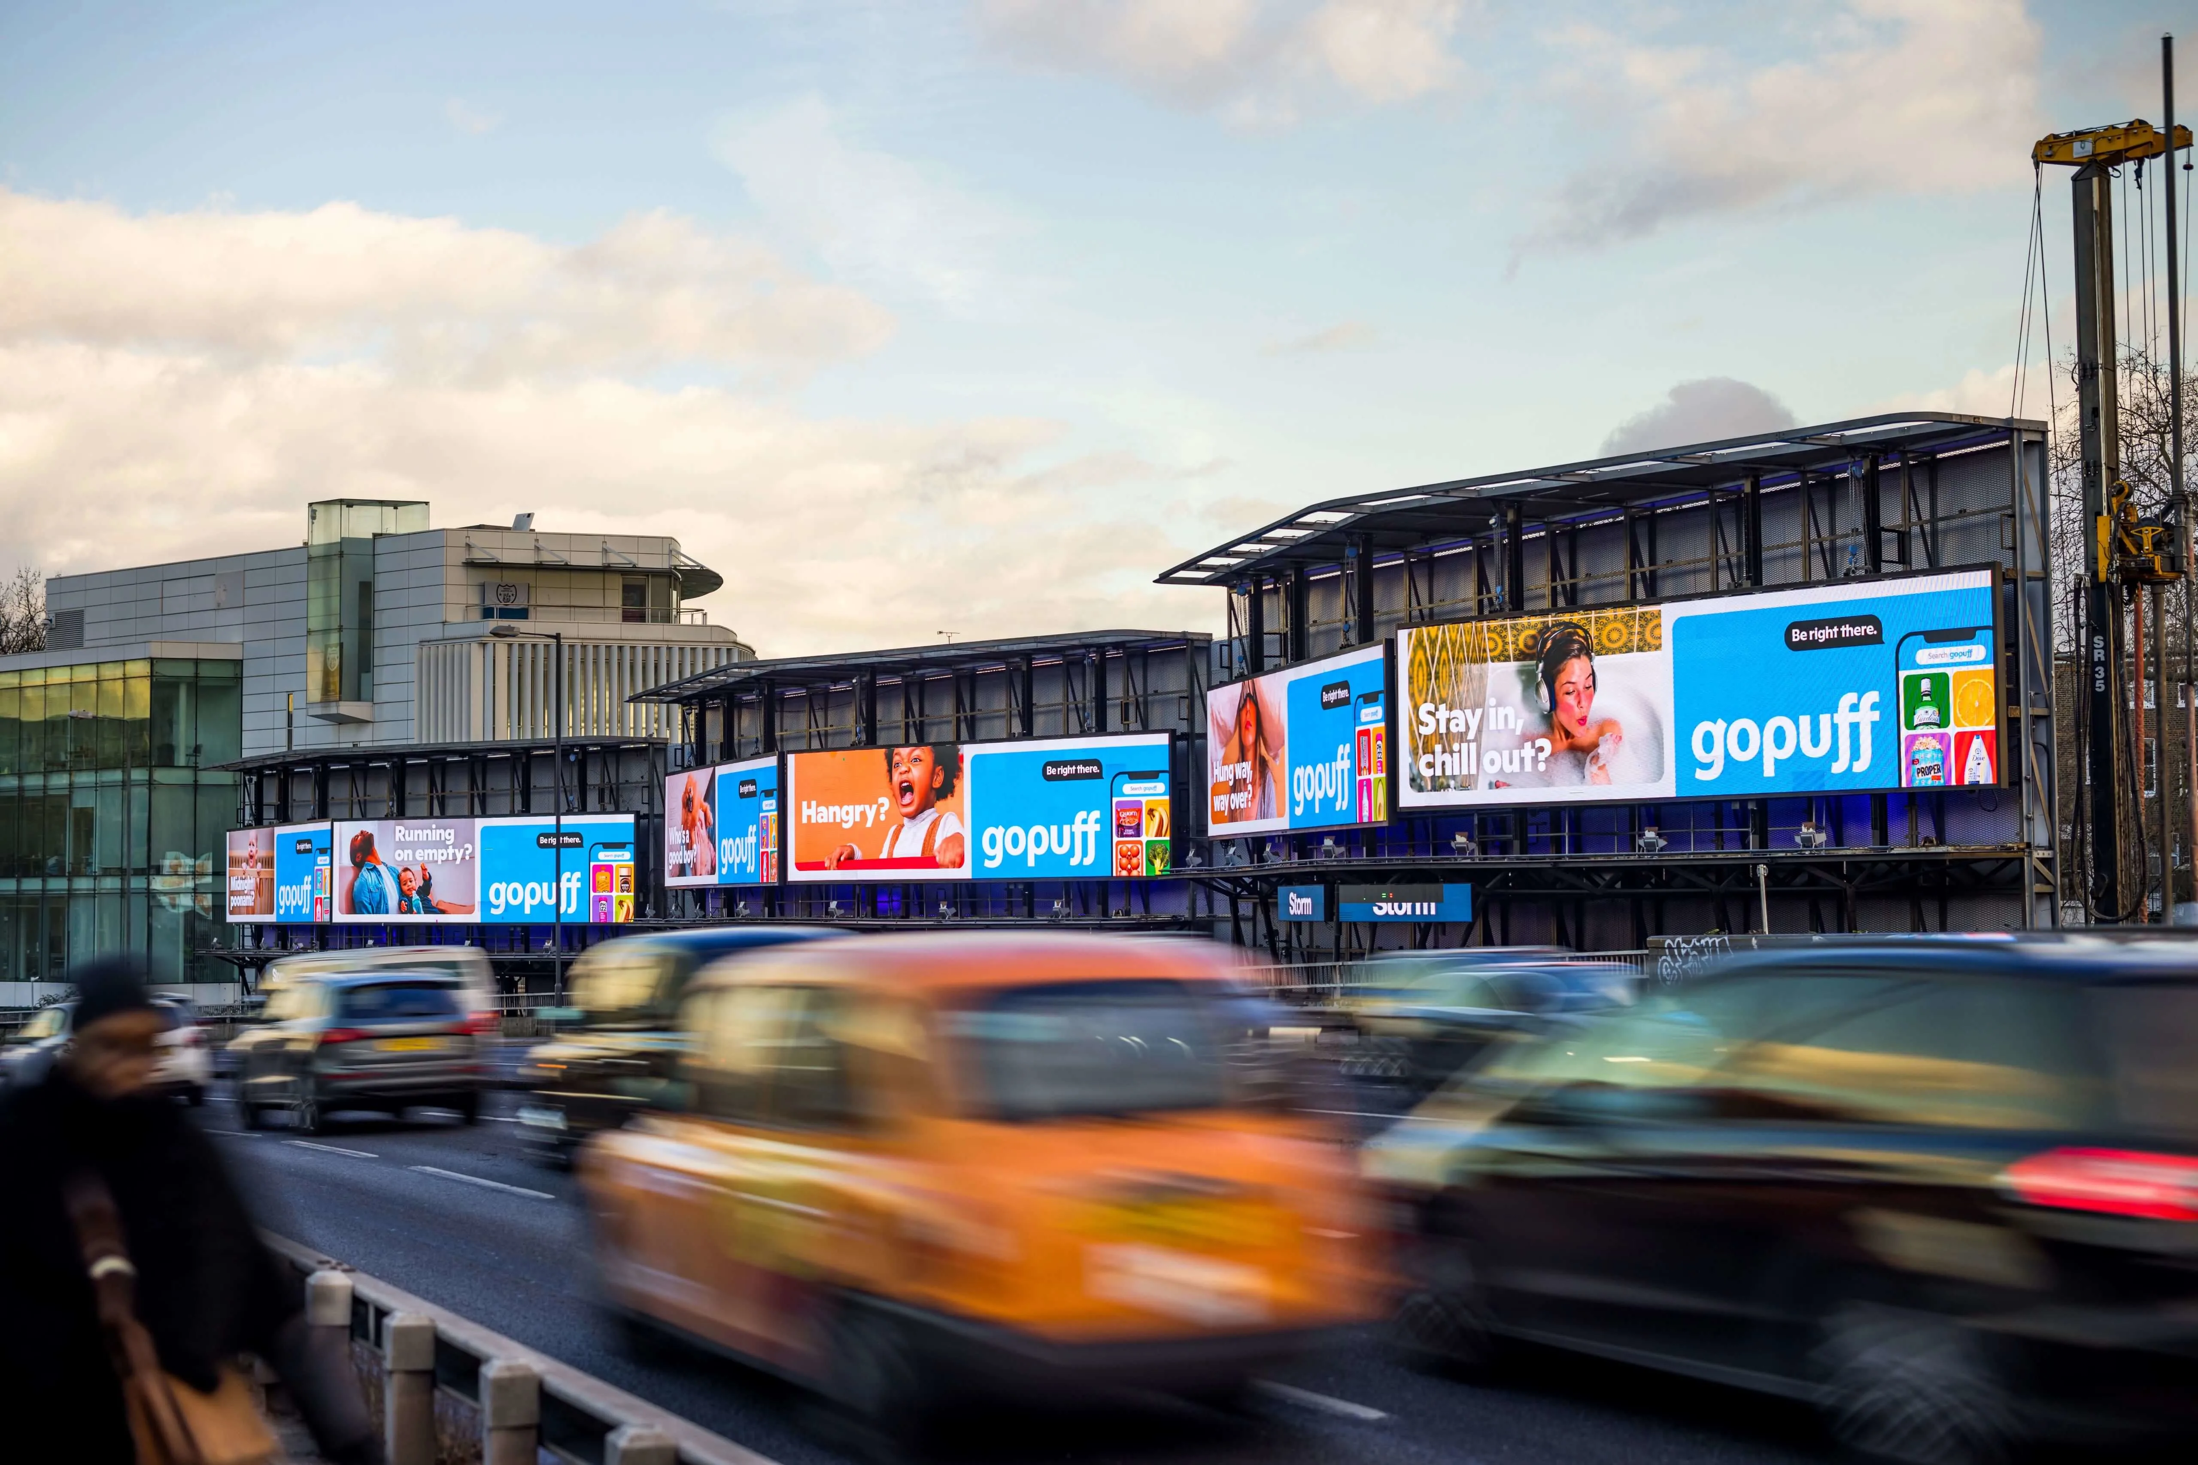


Example uses of linear regression
Advertising – Companies can analyse whether advertising expenses have any correlation to sales.
Medical researchers - May use linear regression to understand the effects of medication dosages on humans and how the dosage can be appropriately adjusted.
Sport Data Scientists – Use linear regression to measure the effect of different training regiments on athlete performance.

Slide 7
Bayesian regression
Functions similarly to Linear Regression where instead of just using observed data, Bayesian regression combines the data with prior knowledge to estimate the parameters of the model.
An ideal choice when the data is complex or ambiguous.
Is able to handle extreme outliers, making it more stable.

Slide 8
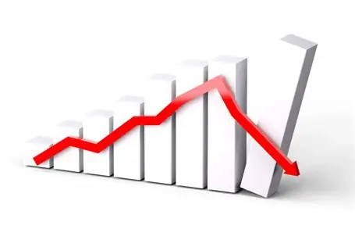

Example uses of Bayesian regression
Stock Market Analysis – Traders will often use Bayesian algorithms to predict future stock prices based on current and past data. (SMART GAMBLING)
Spam Detection – Email providers heavily rely on Bayesian filters to calculate the probability of certain keywords and sender addresses being spam.

Slide 9
Decision tree regression
Label these features
Used to predict continuous values by using a tree-like structure.
It splits the data up into smaller parts based on simple rules.
The end of each branch is called a leaf node which is where the predicted values are given.

Slide 10
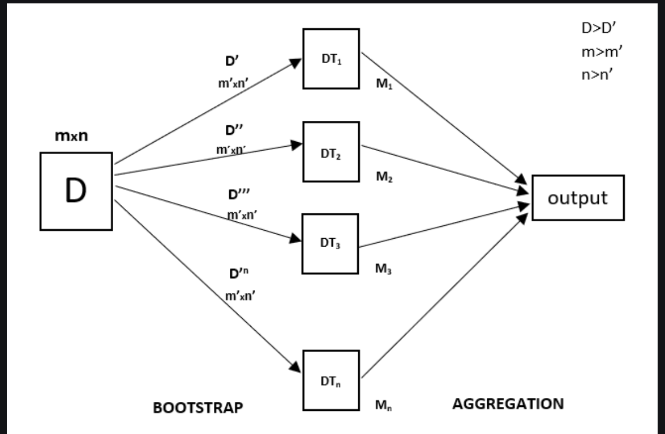
Random forest regression
Random forest regression combines the predictions from multiple decision trees to produce a more accurate prediction.
The process starts with bootstrap sampling where random rows of data from a dataset are selected to form different training datasets for each tree.
Feature sampling is the next step where a random subset of features are chosen.
Aggregation is the final stage where the average of all the individual tree predictions is found.

Slide 11


Example uses of random forest and decision tree regression
Stock management – In retail, companies will feed data such as: Sales Trends, Seasonal Demand and Supplier lead times into decision trees to generate a prediction of how much each product is needed.
Customer Targeting – Online stores that show you exactly what you want are able to do this through grouping customers based on certain factors and using these to create accurate predictions on what products you want to see.

Slide 13
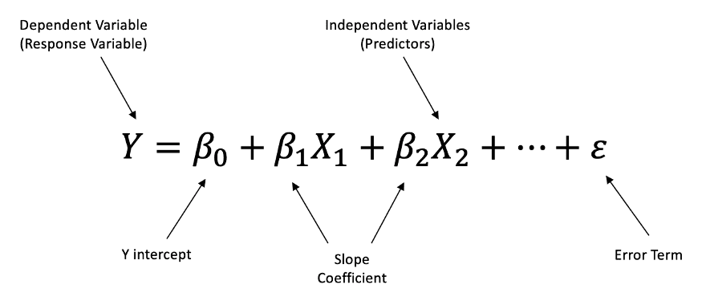

Slide 14
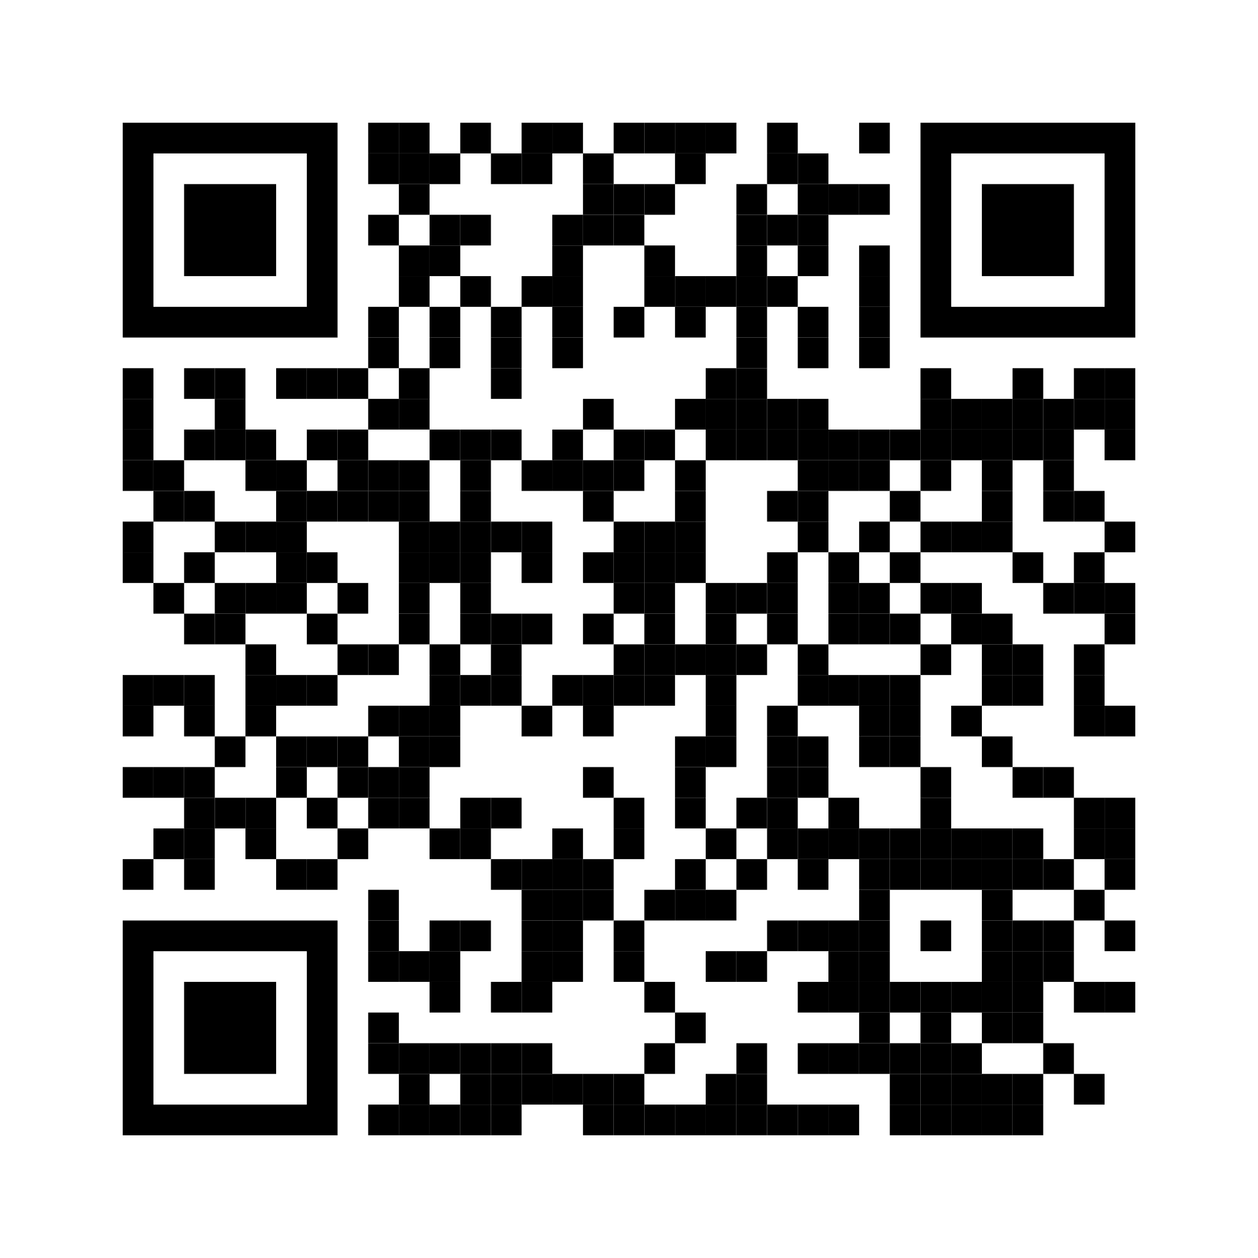
https://github.com/rhyanb01/BOTSQUAD/tree/week-3

